Slide 1


INFO 6210 GROUP 12
Kaiyuan Zhao
Hao Zhang
Shaodong Wang
Zijiao Long

Slide 2


Mission Purpose
Purpose
Video games has become popular nowadays
Video game companies need a way to present their game data visually,
Publishers need to handle with the whole game market and make sale strategy
They also need a well-managed system from their employees
What will we achieve?
Perform the best way for players to find the games
Supports the best way for game companies to maintain and update for their data

Slide 3

Database Design
Mission Statement
Mission Objective
ER Diagram

Slide 4

Mission Statement
The database is to maintain the data of video game sales from 1995-2016 on various platforms. It will be used for analysis and future prediction

Slide 5

Mission Objectives
Maintain(enter, update and delete) data on Games(such as game’s name, platform, year of release)
Perform search on Games(such as game’s name, platform, year of release)
Track the most popular Games(such as by numbers of sales on a particular region, numbers of sales on a particular platform)

Slide 6
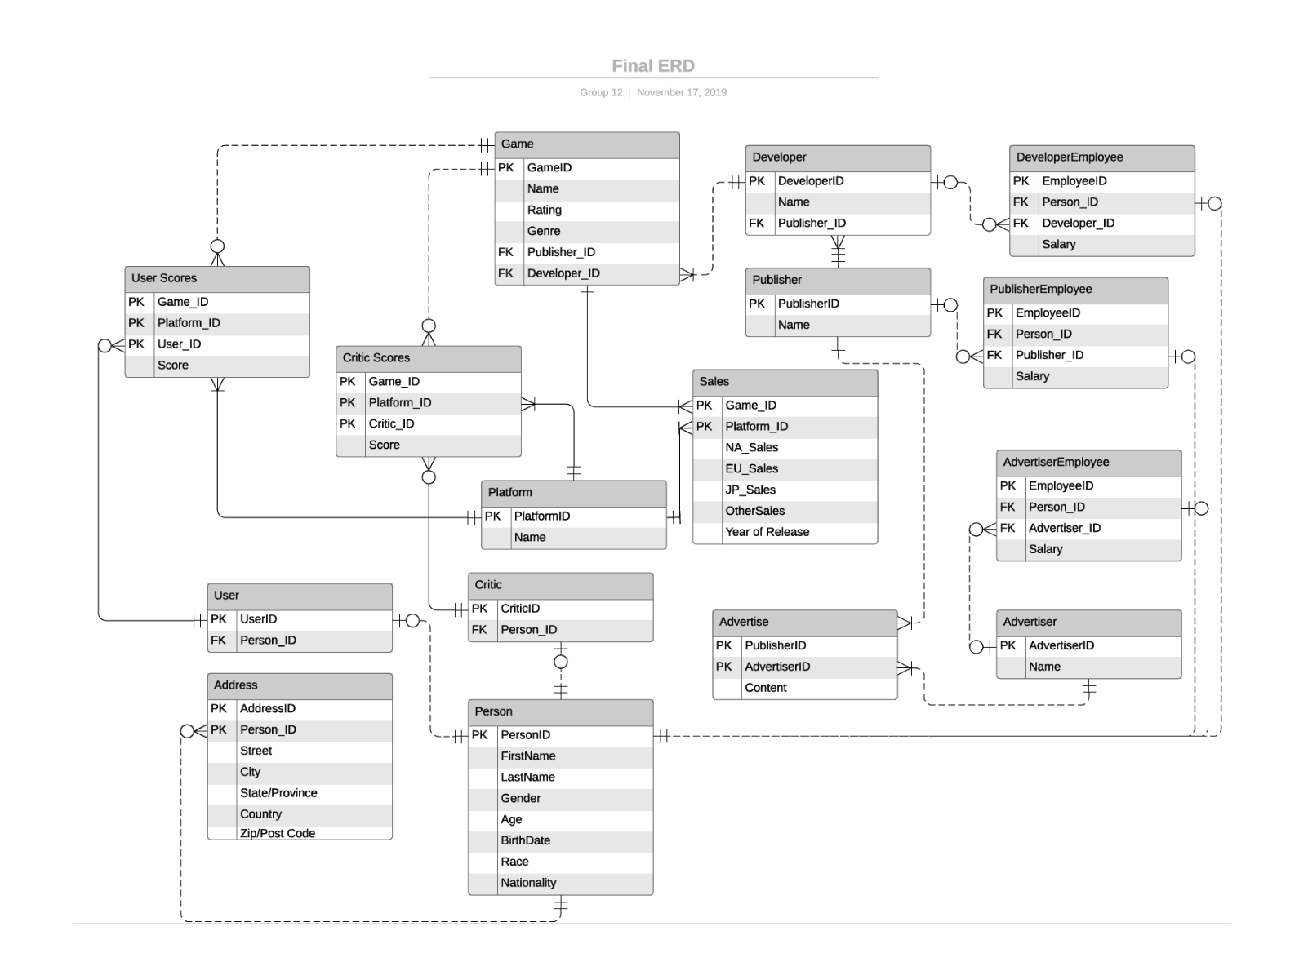
ERD

Slide 7

Implementation
SQL Script, SQL View and visualization using Power BI

Slide 8
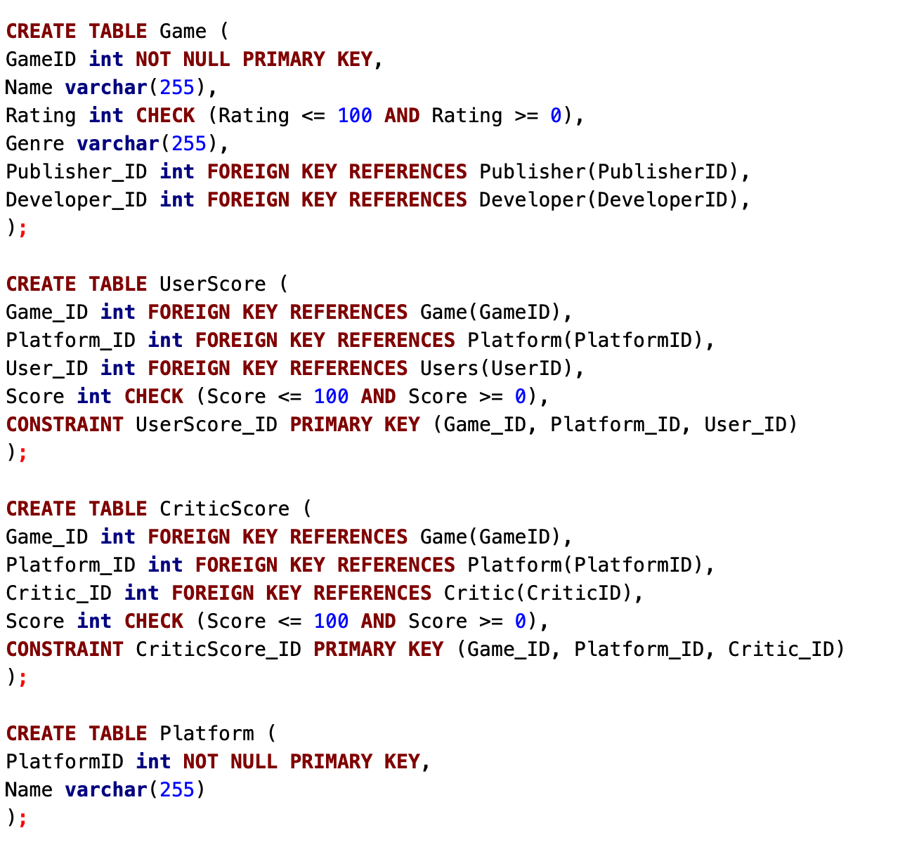
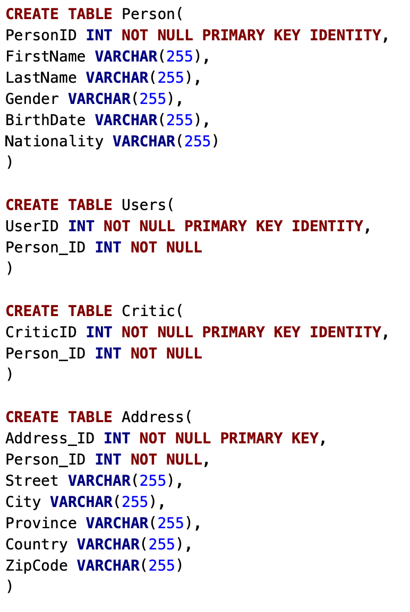
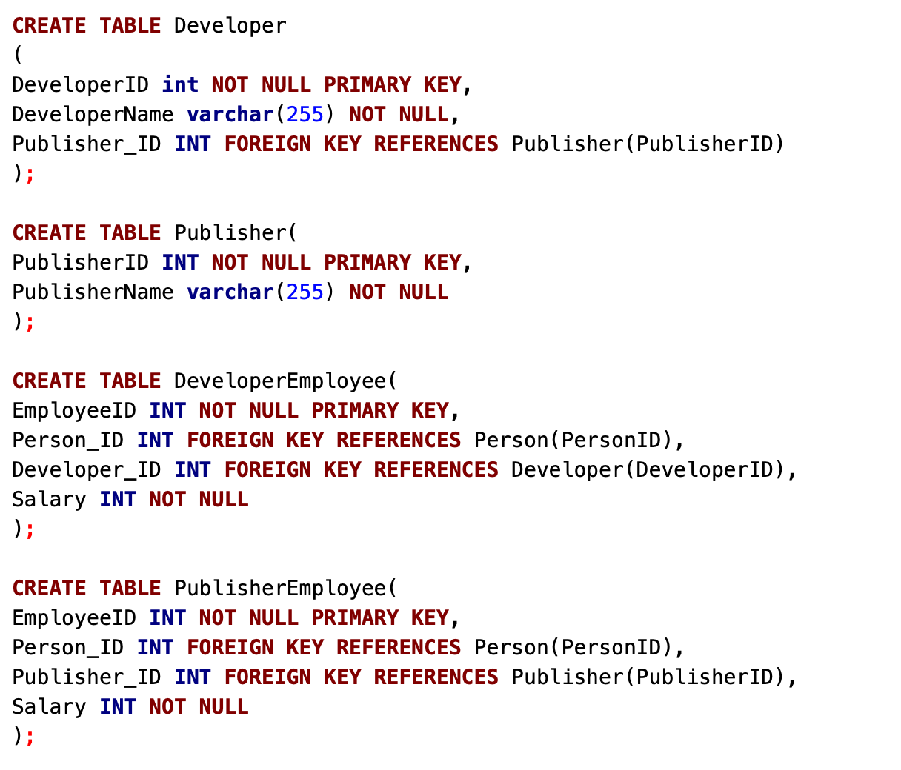
Creating Tables

Slide 9
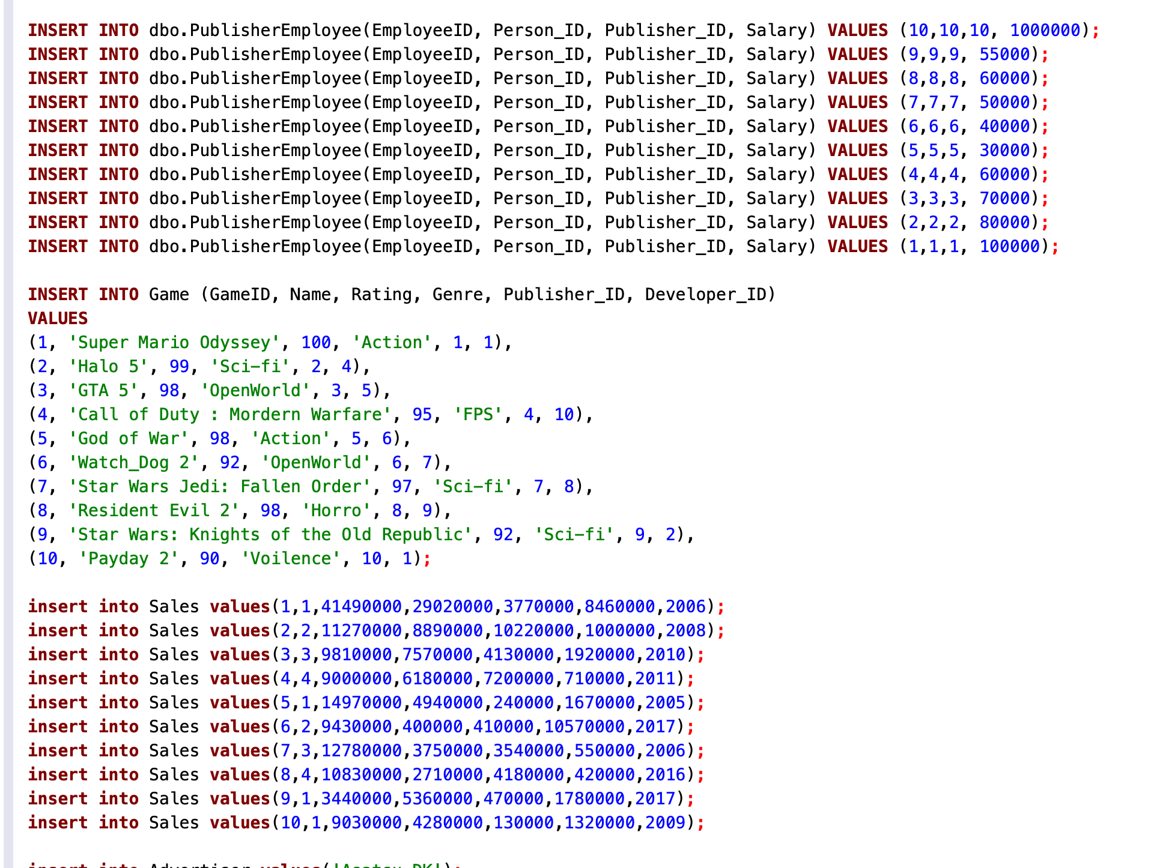
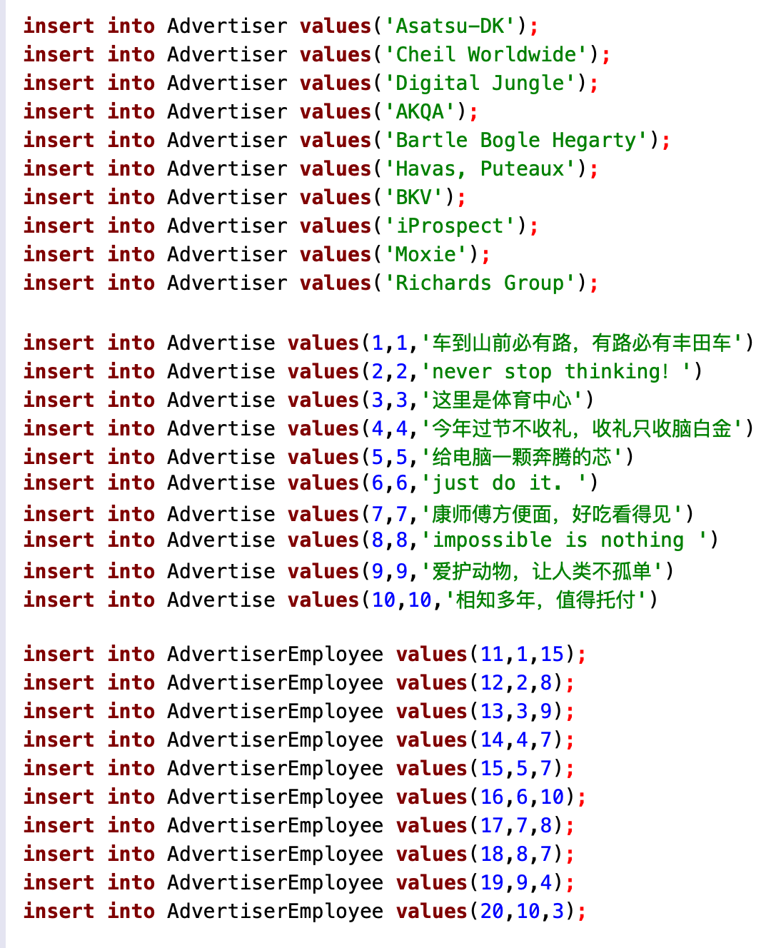
Inserting Values

Slide 10
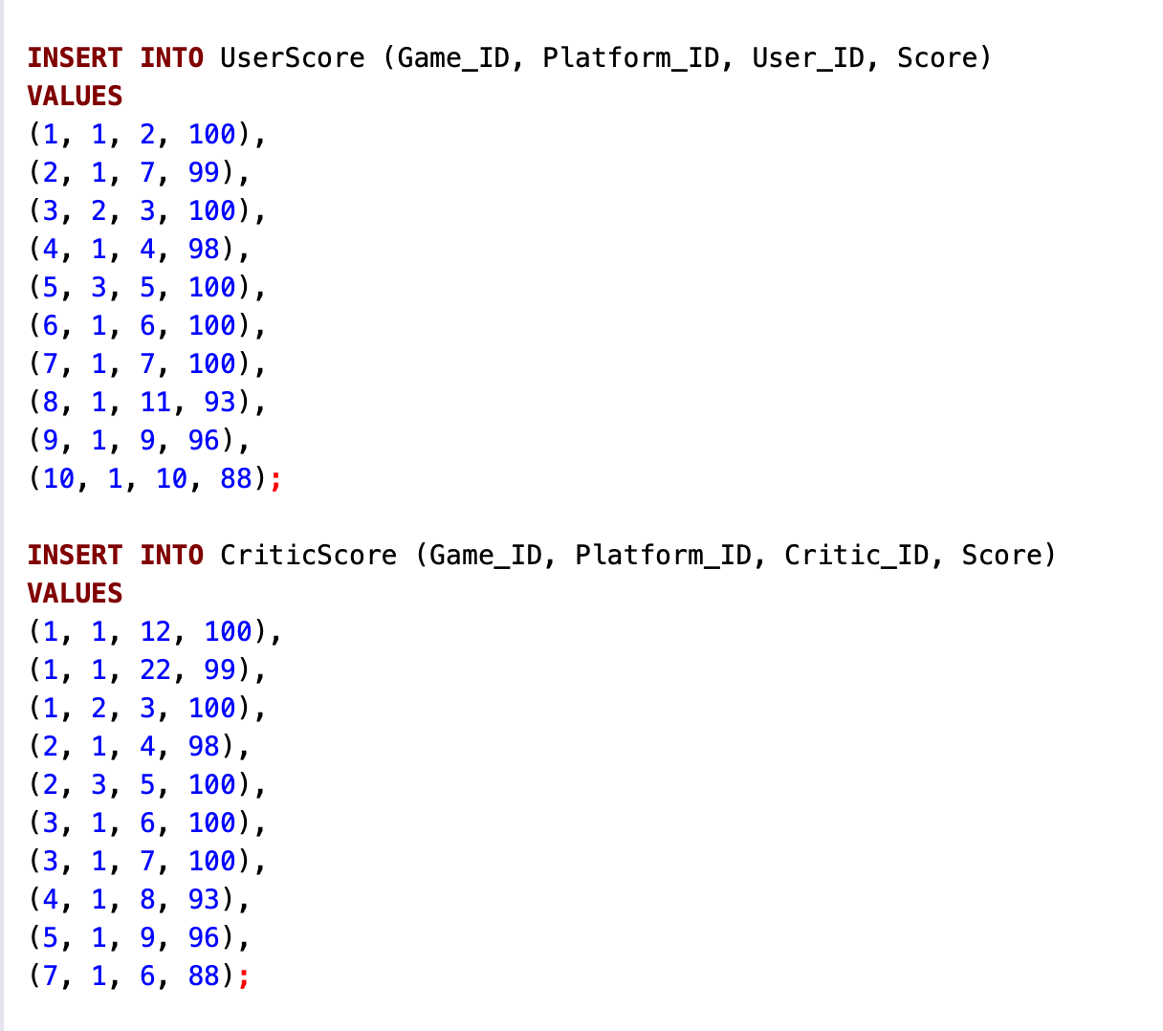
Inserting Values(Continue)

Slide 11
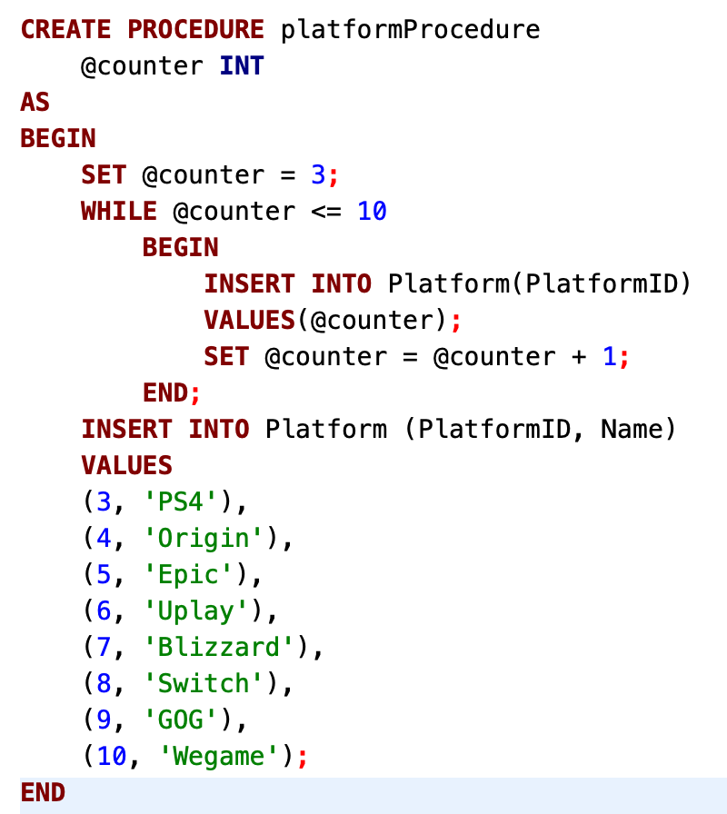
Create Stored Procedure

Slide 12
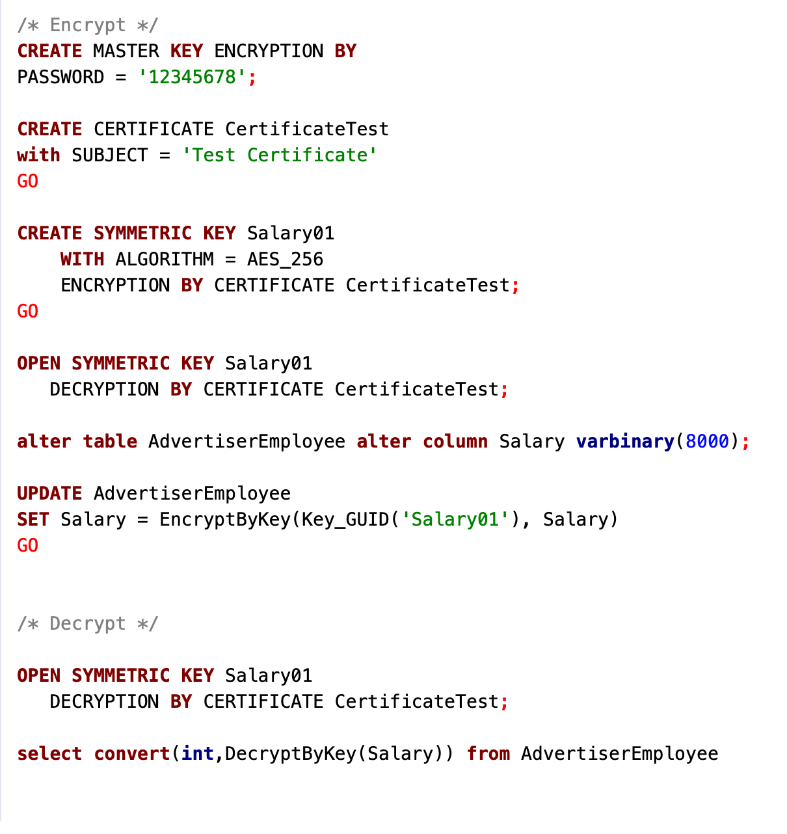
Encrypt And Decrypt

Slide 13
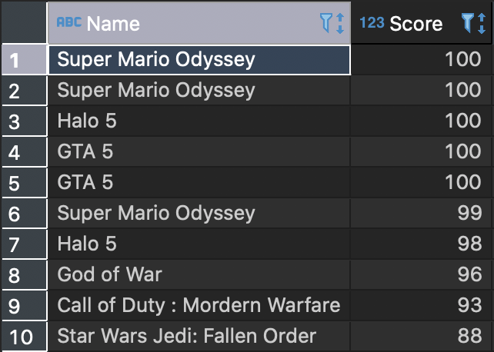
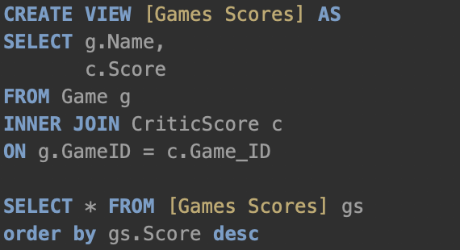
SQL VIEW

Slide 14
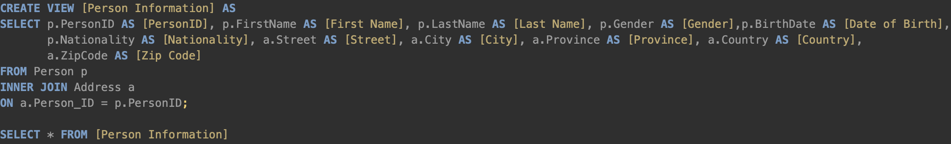
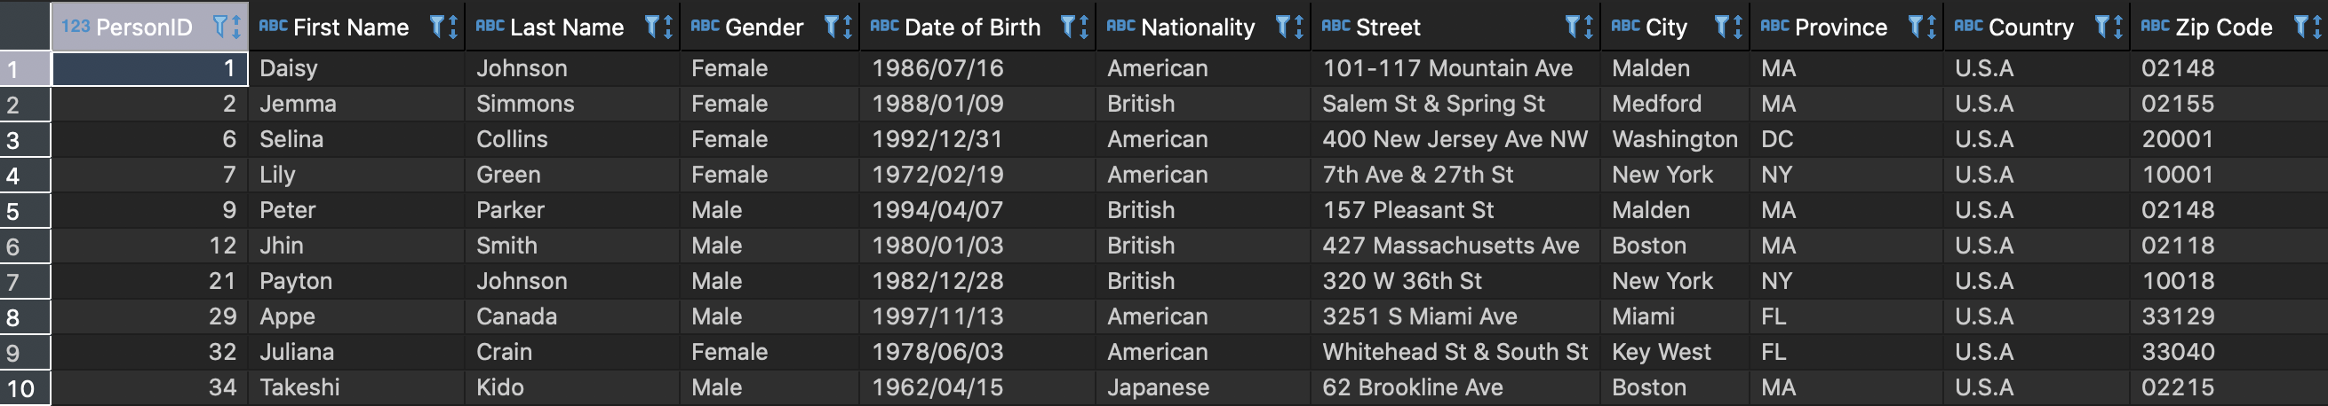
SQL VIEW

Slide 15
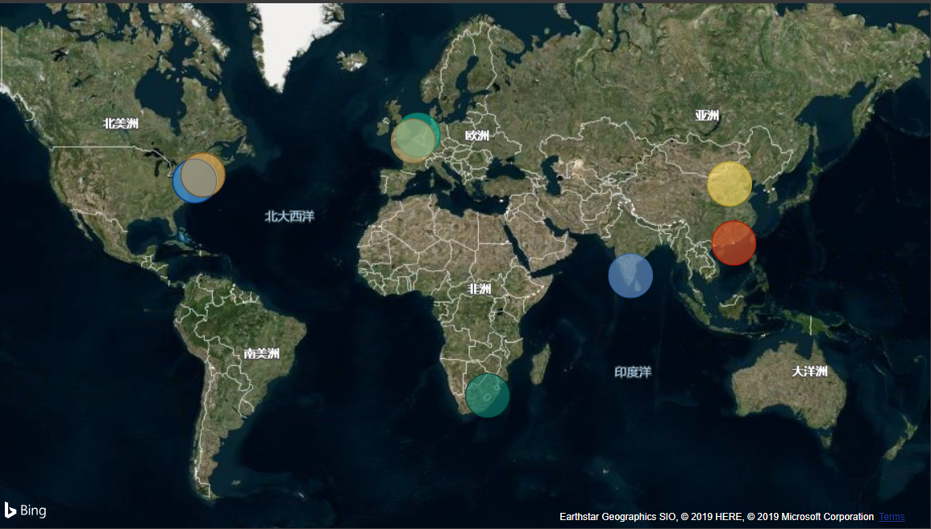
EMPLOYEES ADDRESS VIEW ON MAP

Slide 16
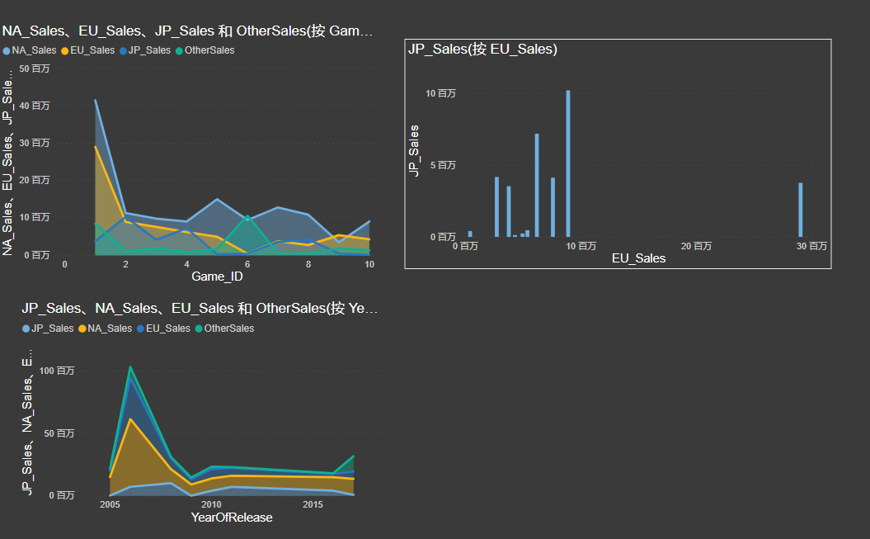
SALES RESULT BY POWER BI

Slide 17

INFO 6210 THANK YOU!

